Slide 1
EMA/WGLG Service Review Forums 2025
FE Account Managers, Partner Services
Kay Vizard-Kotkowicz
Katy Barge
April 2025

Slide 2

Agenda
Common queries
Portal enhancements, you asked we delivered
Online application
Application and promotion
Fact finding
Service standards
Service update
AOB

Slide 3

Common Questions
Q) Where can I find the payment information guide?
On portal in the downloads section – and on the LC website
Q) Under what circumstances should I use remove, stop, suspend ?
Remove – When a student has not signed a learning agreement, suspend is when they have signed a LA and you have a long-term sickness/ AWOL, stop is when they have signed a LA and have decided to withdraw – Removed is now not an option once a LA has been signed.
Q) After how many days should we remove a student from the LC Portal if they haven’t yet signed a learning agreement?
You should remove any students who have not signed a learning agreement within 10 working days. This ensures that student’s who have not returned to study are no longer on your portal and will also help to protect your service standard of getting learning agreements signed within 10 working days.
Q) If a student is off ill, how long can we continue to pay them their EMA ?
A) 3 Weeks, with evidence required after 5 days. This should be reviewed after 3 weeks to determine if it is long term sickness.

Slide 4
Portal enhancements

Slide 5


You Asked & We Delivered
The remove box now disappears once a learning agreement has been signed
You can now search for removed students from the application worklist. You must input name and DOB.
Average days counter will now re set to 1 day when a student is transferred from one LC to another.
On our wish list – Re set average days
If an application is awaiting information and the average days are still counting (typically when they have been sample checked).

Slide 6
Online application for EMA/WGLG

Slide 7

Tell us more
Have you attended an online demo session, if not the next sessions will be held on 1st and 6th May 2025
Are you offering students help and support with their online application
Learning Centre’s should promote the online application to your students over applying on paper
Please provide SLC with feedback from your students regarding the online application experience

Slide 8
Household income Threshold increase for 25/26
Starting from the new academic year in September 2025, the threshold for households with one dependent child will increase from £20,817 to £23,400. This means students in families with a household income of £23,400 or less will be eligible to receive EMA.
The threshold for households with two or more dependents will also increase from £23,077 to £25,974. Therefore, students in families with two or more dependents and a household income of £25,974 or less will be eligible to receive EMA.
Students who were previously ineligible due to their household income being too high may now be eligible from September. Please encourage them to apply if they're still in study by then.

Slide 9
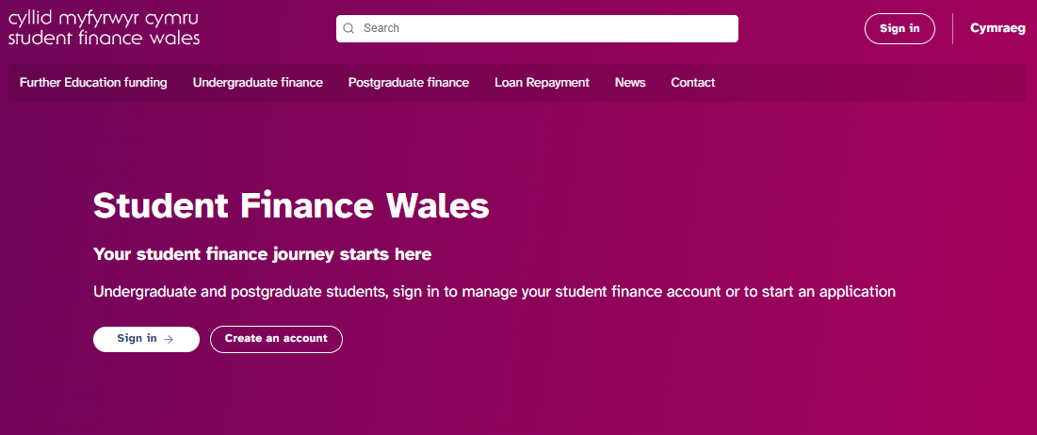
Online application
https://www.studentfinancewales.co.uk/further-education-funding/education-maintenance-allowance/how-and-when-to-apply/

Slide 10
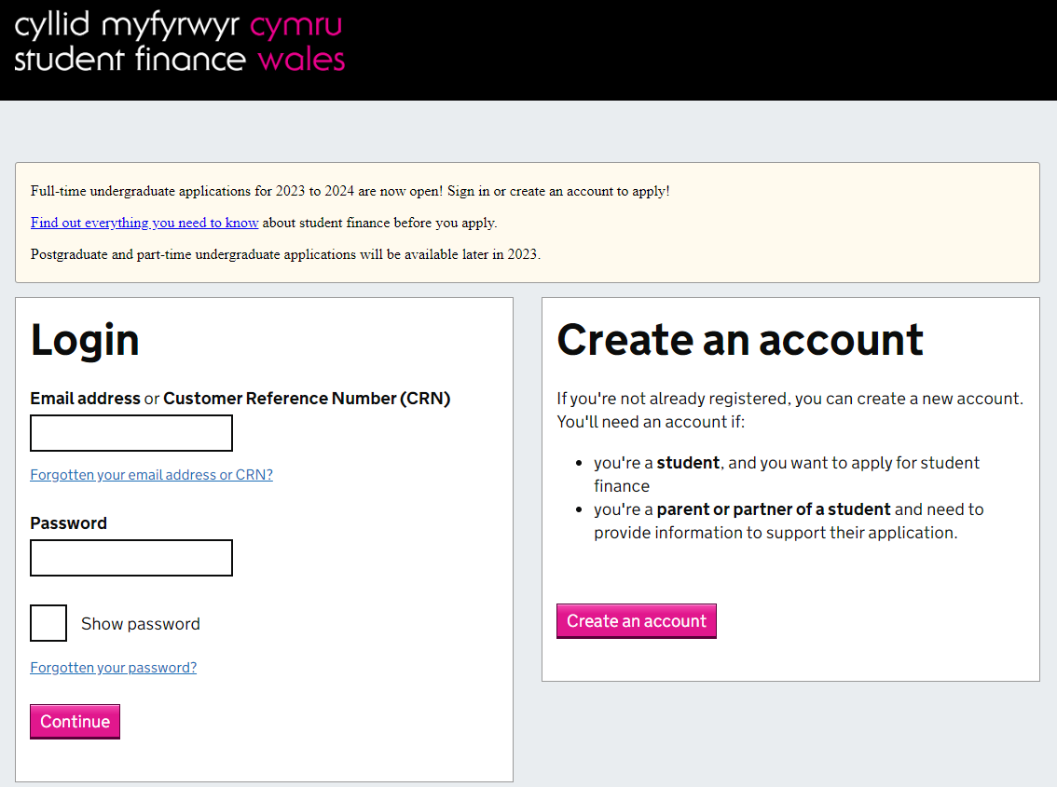
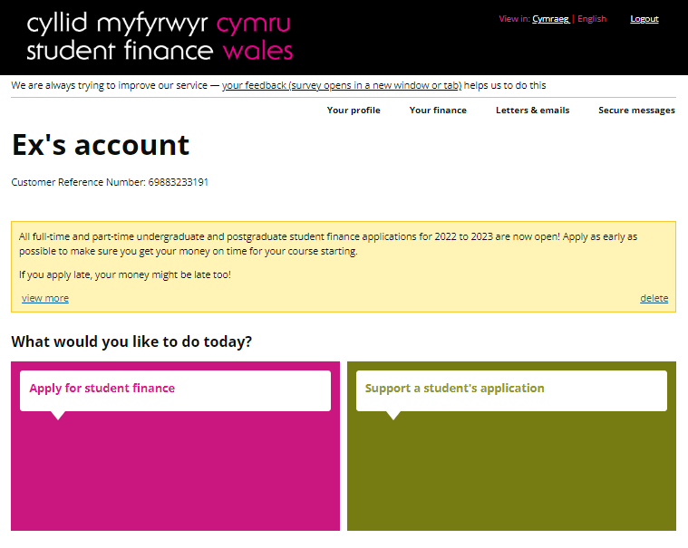
Create an account

Slide 11
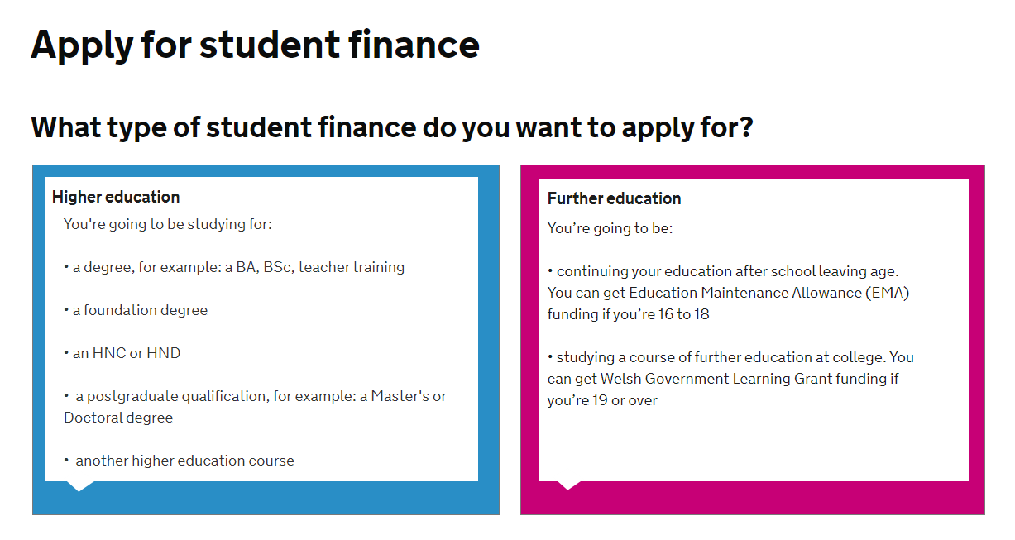


Apply for student finance

Slide 12

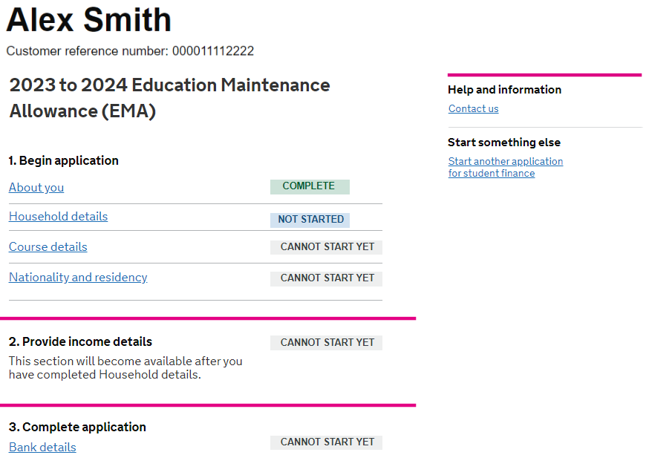
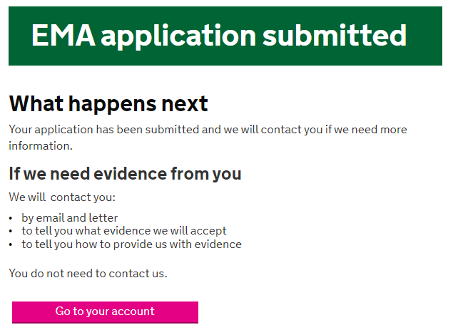
Task List

Slide 13
Home Office Data Share (HODS)
The Home Office is moving to digital and is no longer issuing physical status evidence.
A HODS check is a way for us to carry out a check with the Home Office to validate the student's status digitally. A valid HODS check can be accepted as proof of identity and status.
When applying, online or by paper, the student will be asked to provide;
Document Type
Document Number*
Date of Birth
Document Issuing Nationality
* From a Passport, ID card, HOBRC or HOBRP.
If the student is applying through a family members status, they will also be asked to provide all of the above for their family member. In addition to this they need to provide proof of relationship evidence.

Slide 14
Welsh Government Update

Slide 15
Participation and attendance
Supporting the Minister’s ambition for everyone to have access to the same opportunities and to remove barriers to post-16 participation:
We have maintained the weekly rate of EMA at £40
Uplifted the EMA household income thresholds for academic year 2025/26, ensuring more learners will receive EMA
Attendance and discretion:
Encourage confidential conversations.
Consider wider impact of non-attendance before submitting to SLC.
Has discretion been considered? Is further discussion required?
Improved guidance for service partners
Improved student facing guidance around payments and attendance – encourage the conversation.
Prevent the cycle of non-attendance

Slide 16
Application and promotion

Slide 17
EMA/WGLG Promotion – time to share
What do you currently do to identify possible EMA/WGLG eligible students ?
Do you promote EMA/WGLG within your Learning Centre ? If so how and when do you do this ?
Which promotional resources that SLC provide do you currently use if any ?
Little book of EMA
Guide to WGLG
Coming soon posters
Posters to apply now with QR Code
PowerPoint to use on TV screens
What other promotional materials do you think would work well to catch students/parents' attention to EMA/WGLG ?
Do you use Parent-pay, Class-charts ,Free school meals etc
If you don’t currently do promotion what is the reason?

Slide 18
25/26 Service Launch
Launch is planned for April 28th 2025
Online and paper will both launch at the same time for the first time.
The 2025/26 EMA/WGLG academic year start date will be Monday 8 September 2025. This is when we begin to count the 10-day period for students to sign their learning agreements.
Learning Agreements 25/26 will be available from week comm 28th April 2025.
Auto rollover for Returning students will be on 1st June 2025.
EMA/WGLG application forms were delivered week comm 24th March 2025 please contact emainfo@slc.co.uk if you have not received them.

Slide 19
EMA Wales Application Numbers
Month Application Received | 22/23 | 23/24 | 24/25 | 23/24 & 24/25 Variance
April | 16 | 100 | 131 | 31.0%
May | 370 | 485 | 362 | -25.4%
June | 754 | 992 | 958 | -3.4%
July | 834 | 976 | 1,256 | 28.7%
August | 1,787 | 2,460 | 2,689 | 9.3%
September | 8,236 | 8,422 | 9,036 | 7.3%
October | 2,530 | 2,393 | 2,360 | -1.4%
November | 816 | 872 | 880 | 0.9%
December | 299 | 302 | 266 | -11.9%
January | 226 | 241 | 235 | -2.5%
February | 155 | 151 | 163 | 7.9%
March | 116 | 99
April | 53 | 53
May | 34 | 23
June | 18 | 13
July | 7 | 10
August | 7 | 13
Total | 16,258 | 17,394 | 18,336 | 5.4%

Slide 20
WGLG Application Numbers
Month Application Received | 22/23 | 23/24 | 24/25 | 23/24 & 24/25 Variance
April | 2 | 4 | 6 | 50.0%
May | 35 | 25 | 27 | 8.0%
June | 107 | 66 | 39 | -40.9%
July | 144 | 105 | 115 | 9.5%
August | 239 | 304 | 241 | -20.7%
September | 1,133 | 1,293 | 1,286 | -0.5%
October | 662 | 708 | 624 | -11.9%
November | 343 | 343 | 279 | -18.7%
December | 196 | 150 | 107 | -28.7%
January | 176 | 161 | 147 | -8.7%
February | 130 | 106 | 78 | -26.4%
March | 92 | 83
April | 47 | 48
May | 56 | 57
June | 15 | 12
July | 2 | 7
August | 1 | 8
Total | 3,379 | 3,480 | 2,949 | -15.3%

Slide 21
Fact Finding – Learning Agreements

Slide 22
Example of a realistic and fair Learning agreement
To receive your EMA you must attend 100% of your timetabled lessons
Authorised absences can be considered as in attendance, a list of these can be provided by your school/college. The school/college have discretion if they believe the absence not to be genuine
If you are ill, you can self certify for up to 5 days in a row. After this, evidence such as a medical certificate will need to be provided.
Any unauthorised absences will result in non-payment of EMA (evidence to support an unauthorised absence may be accepted within ** weeks (you can input what you think is acceptable time frame) of the absence
Any holidays authorised during term times will not be eligible for EMA payment
You must be studying a course of a minimum of 12 hours a week to be eligible for EMA. For example, if the student is expected to attend for 20 hours, they must attend for 20 hours
If you wish to appeal and attendance confirmation decision’s, please ask the learning centre for further guidance https://www.lcservices.slc.co.uk/ema-wales/guidance/guidance-notes-for-ema-learning-centres-in-wales/record-keeping-and-appeals/appeals/

Slide 23
AY 24/25 Performance against Service Standards

Slide 24
Service Standards
Service Measure | Standard
Learning Agreement Confirmations | New Students: 100% Within 10 Working Days of an Approved Application (SLC provides start date, 2nd Monday in September) Returning Students: 100% Within 10 Working Days from the first full week of Academic Year – (SLC provides start date, 2nd Monday is September)
Attendance Confirmations | EMA: 100% Attendance Confirmations Weekly WGLG FE: 50% Oct/Feb/May 100% Dec/March/June
Notice of Changes (WGLG FE) | 100% Within 10 Working Days (from when the change occurred)
Removals (Outstanding Learning Agreements) | 100% Within 10 Working Days of Approved Application by first full week of Academic Year
Withdrawals | 100% Within 30 Working Days

Slide 25
WGLG Learning Agreement & Attendance Confirmations
New Students: 100% within 10 working days of an approved application
Returning Students: 100% within 10 working days from the first full week of academic year
 | 22/23 | 23/24 | 24/25
Learning Agreement Average Days | 5 | 5 | 5
WGLG FE Attendances: 50% Oct/Feb/May (mid term)
100% Dec/March/June (end of term)
Date | 23/24 | 24/25 | Notes
Oct (mid term) | 86.5% | 95.1% | 50% Requirement
Dec (end term) | 95.6% | 97.3% | 100% Requirement
Feb (mid term) | 95.7% | 86.8% | 50% Requirement

Slide 26

EMA Learning Agreement & Attendance Confirmations
New Students: 100% Within 10 Working Days of an Approved Application
Returning Students: 100% Within 10 Working Days from the first full week of Academic Year
 | 22/23 | 23/24 | 24/25
Average Days | 8 | 7 | 7
EMA: 100% of attendance confirmations required each week
 | 23/24 | 24/25
EMA Payment week | 97.2% | 98.8%
 | 23/24 | 24/25
EMA Non-Payment week | 94.1% | 97.3%

Slide 27
Important updates
Link - We have a couple of links that users currently use to access the LC Portal. One of these links is an old link that we will be stopping using April 1st.
The link everyone should be using is https://www.lcservices.slc.co.uk/
Sample check - The summer sample check will be stopping and instead is being replaced with a household income check for all students. There will be 2 outcomes.
HMRC check keeps the household income below the household income threshold, then the application will automatically progress to Approved
HMRC check moves the household income above the household income threshold, then the application will automatically progress to Missing Evidence and a request for physical income documentation will be sent. This follows the current VHI exception route for new customers. No customers are automatically rejected without going to ME first.
The dependency sample check that is carried out in November will still be in place for EMA and WGLG.
Sample check update , HODS,URL for log in, old one being disabled.

Slide 28
Over to you
Contribute to continuous improvement – portal, guidance
Focus on accuracy and timeliness
Drive down withdrawal timescales WGLG
Contact your FE Account Manager if you require further information on the contact within this presentation or you require an update on performance or bespoke training

Slide 29

FE Account Manager
Kay_Vizard-Kotkowicz@slc.co.uk
0776 9165135
PS Support Desk
EMAINFO@slc.co.uk
0300 200 7089 (Select option 5)
This Photo by Unknown Author is licensed under CC BY
Notes:
Partner Services
EMAINFO@slc.co.uk
0300 200 4050

