Slide 1

EMA/WGLG Service Review Forum
April 2026

Slide 2

Agenda
Service standards reports
Promoting EMA/WGLG
Online application
Common questions
Learning Agreement content
Preparing for academic year (AY) 2026/27
Service update

Slide 3


Service standards
You can monitor your Learning Centre’s performance against the service standards at any point of the year. You can:
See how your Learning Centre is performing against the Welsh average
Check to see how many applications you have had over the years
Let’s take a look on the next slide

Slide 4
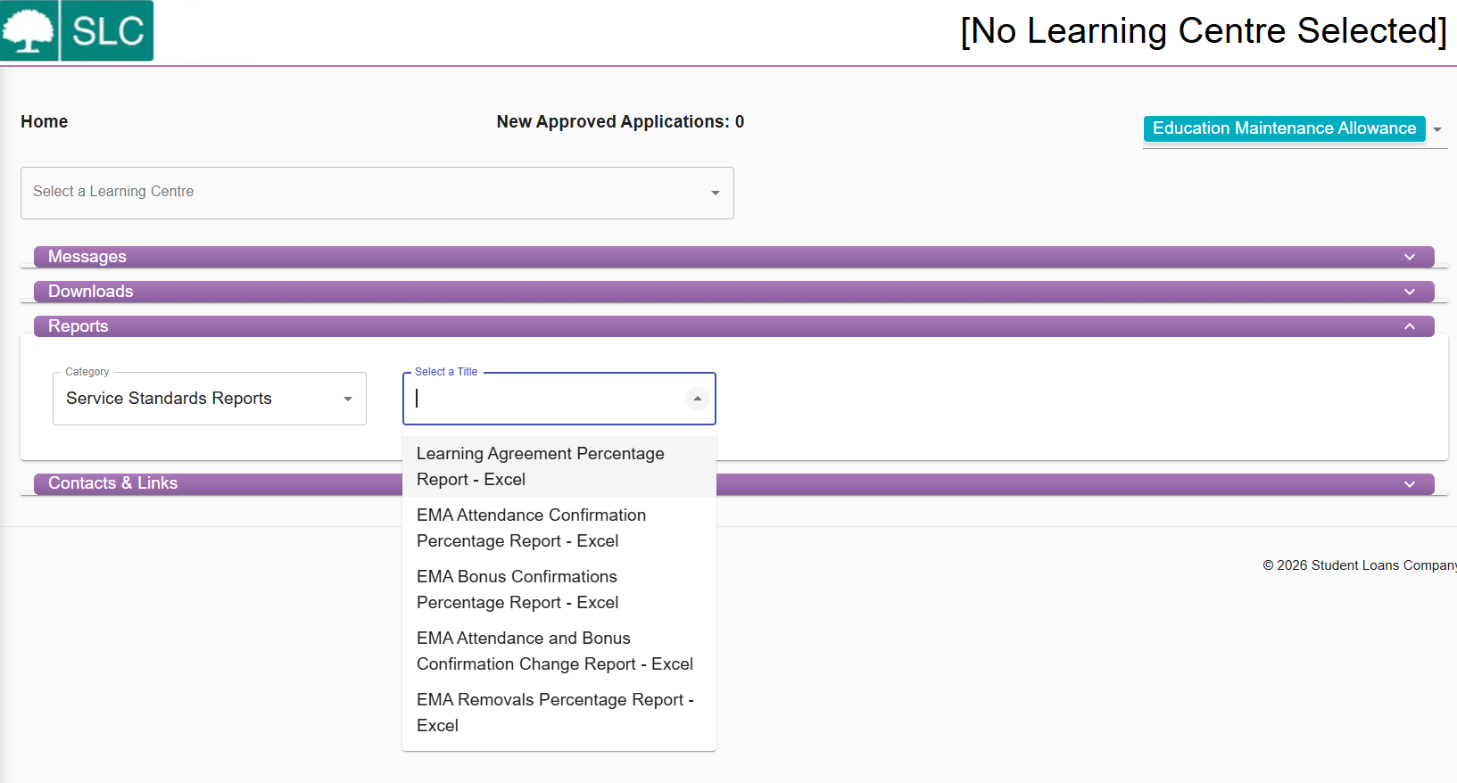
Reports

Slide 5
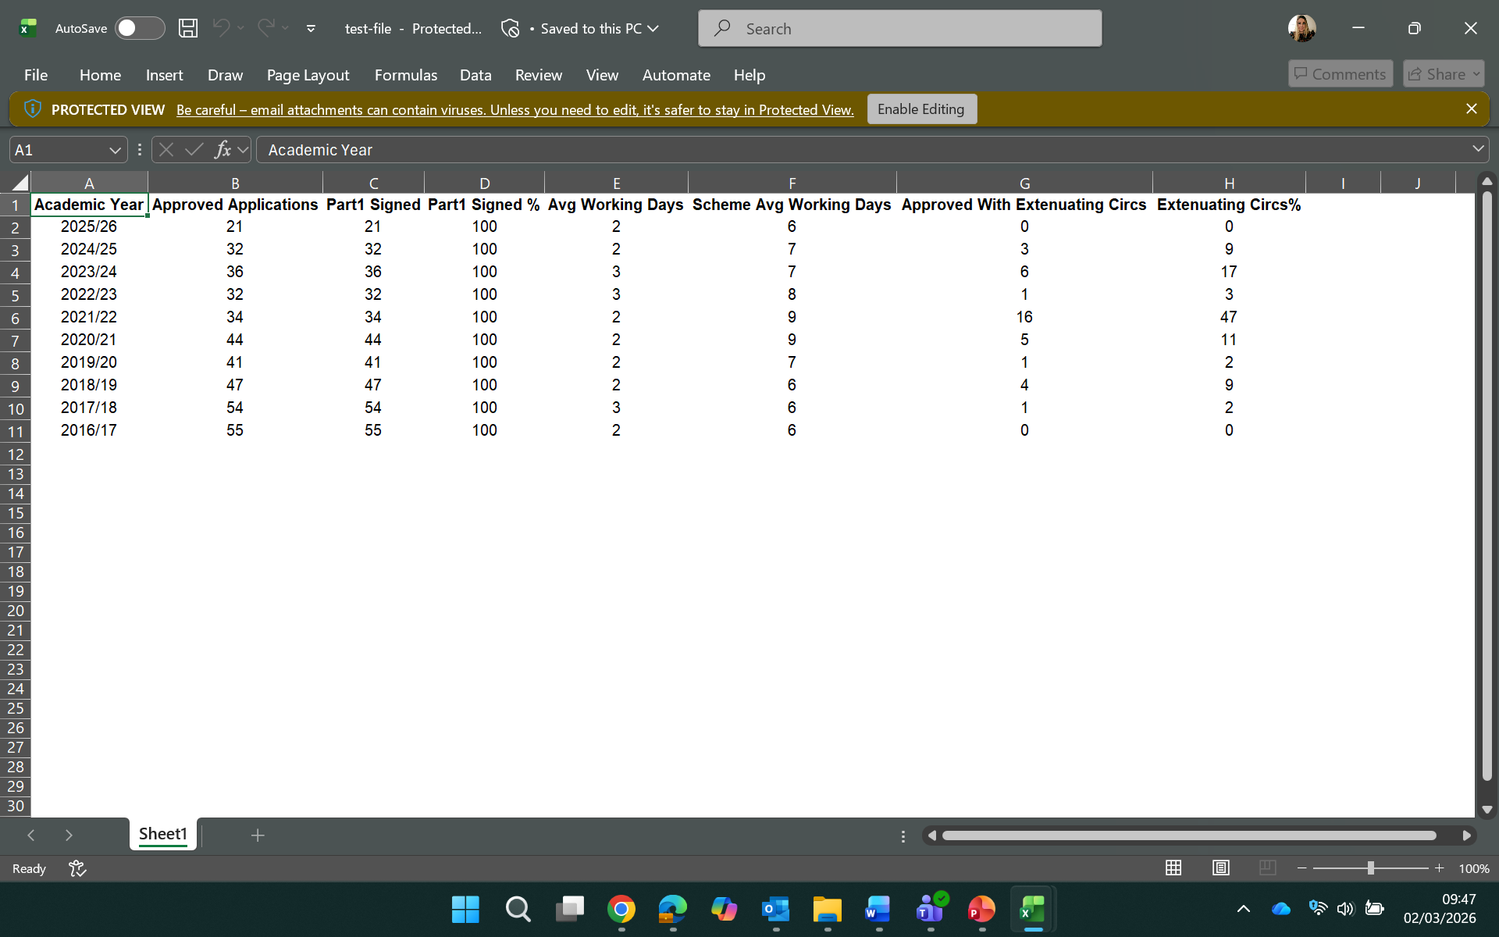
Learning agreement average days

Slide 6
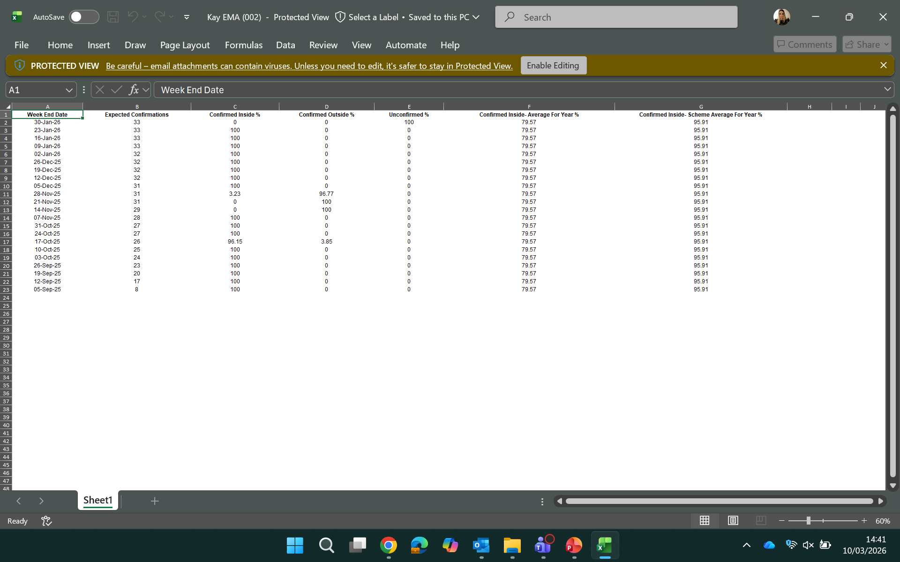
Average attendance confirmations

Slide 7
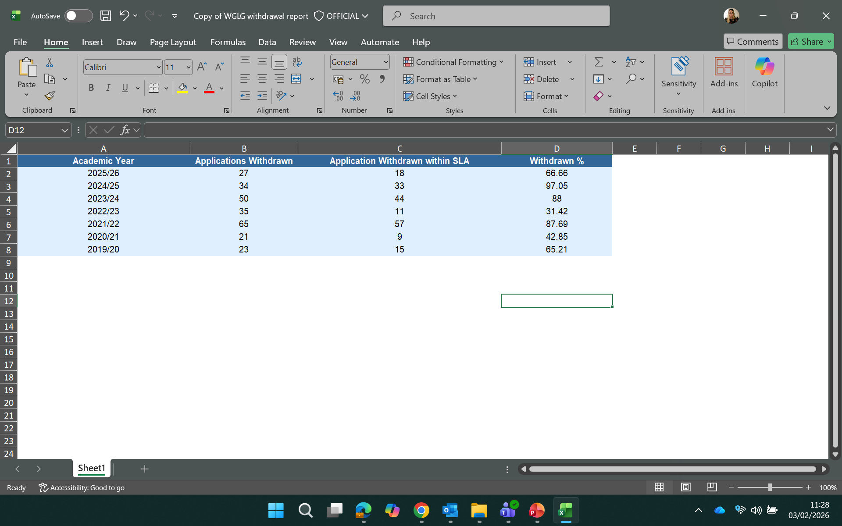
WGLG withdrawals
What are your internal processes?
How can we improve withdrawal submissions?

Slide 8
Promotion – working together
  Which SLC resources do you use to promote EMA?
  Little book of EMA
  guide to WGLG
  coming soon posters
  apply now posters
  presentations to display on screens
How do you identify potential EMA students and promote the funding?
  free school meals info
  parents’ salaries
  class charts
  social media and websites
  open days, enrolment, QR code on notice boards

Slide 9
Timelines
Timeline
We typically launch for the next AY
Encourage students to apply
Coming soon posters
New/returning students - 13-week backdated deadline
March 26
April 26
May 26
June 26
Sept 26
December 2026
Remove non returning students
Learning agreements need signing
Start promoting to year 11
Little book of EMA
Start getting LAs Signed
Guide to WGLG

Slide 10
Applications for EMA/WGLG

Slide 11
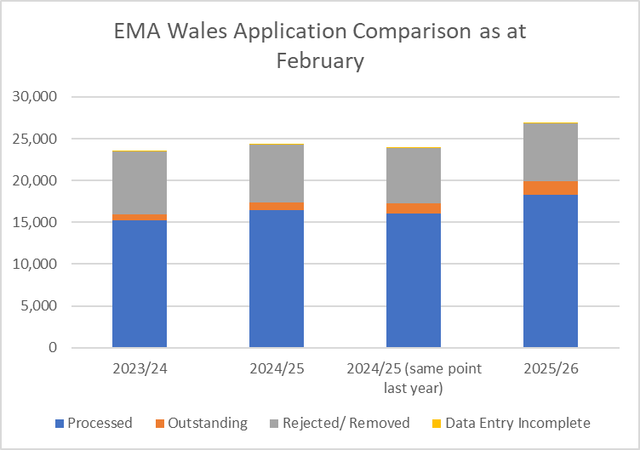
EMA Wales - volume of applications

Slide 12
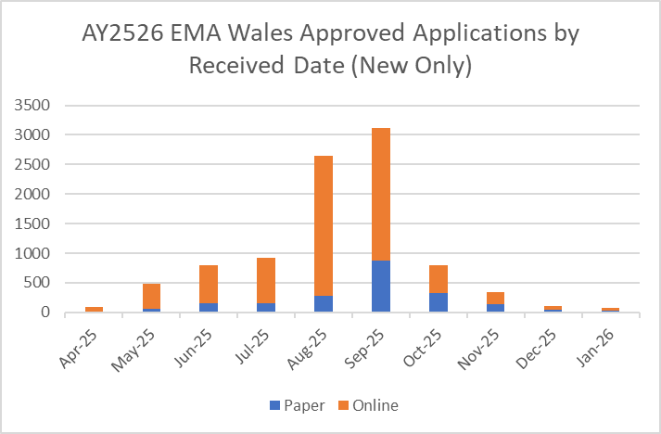
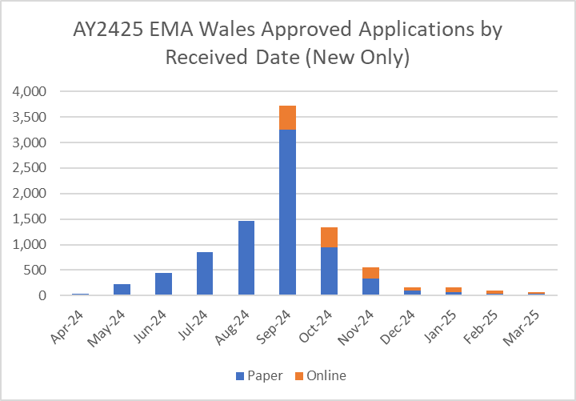
EMA Wales online and paper comparison
AY2526 EMA Wales online and paper comparison
Month | Paper | Online | Online percentage | Total
Apr-25 | 19 | 75 | 79.8% | 94
May-25 | 65 | 412 | 86.4% | 477
Jun-25 | 150 | 644 | 81.1% | 794
Jul-25 | 155 | 764 | 83.1% | 919
Aug-25 | 286 | 2354 | 89.2% | 2,640
Sep-25 | 870 | 2240 | 72.0% | 3,110
Oct-25 | 321 | 477 | 59.8% | 798
Nov-25 | 135 | 213 | 61.2% | 348
Dec-25 | 48 | 59 | 55.1% | 107
Jan-26 | 24 | 47 | 66.2% | 71
Total | 2,073 | 7,285 | 77.8% | 9,358
AY2425 EMA Wales online/ and paper comparison
Month | Paper | Online | Online percentage | Total
Apr-24 | 30 | 0 |  | 30
May-24 | 221 | 0 |  | 221
Jun-24 | 447 | 0 |  | 447
Jul-24 | 849 | 0 |  | 849
Aug-24 | 1,468 | 0 |  | 1,468
Sep-24 | 3,249 | 465 | 13% | 3,714
Oct-24 | 943 | 396 | 30% | 1,339
Nov-24 | 336 | 218 | 39% | 554
Dec-24 | 100 | 65 | 39% | 165
Jan-25 | 73 | 93 | 56% | 166
Feb-25 | 43 | 55 | 56% | 98
Mar-25 | 33 | 29 | 47% | 62
Total | 7,792 | 1,321 | 21.7%* | 9,113
AY2526 EMA Wales Online/Paper Comparison

Slide 13
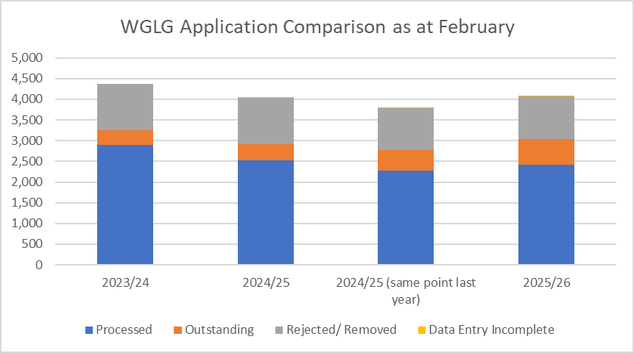
WGLG - volume of applications

Slide 14
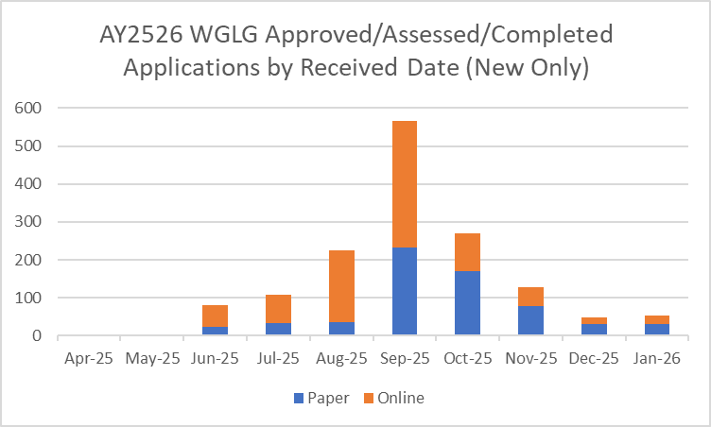
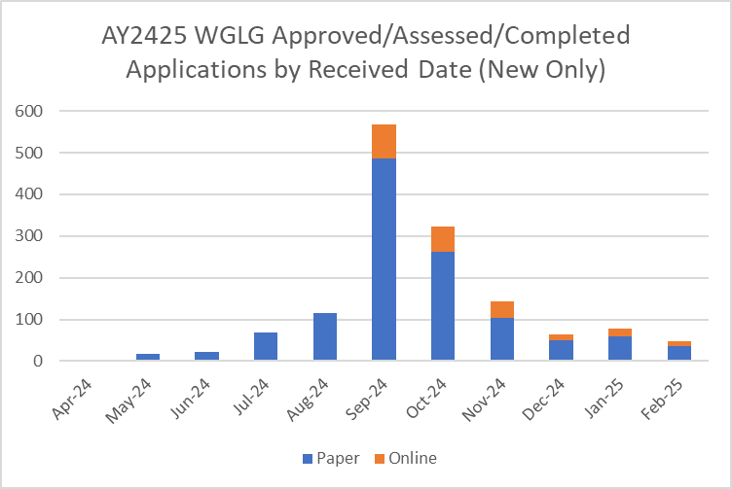
WGLG online and paper comparison
AY2526 WGLG online and paper comparison
Month | Paper | Online | Online percentage | Total
Apr-25 |  |  | 0.0% | 0
May-25 | 3 |  | 0.0% | 3
Jun-25 | 24 | 57 | 70.4% | 81
Jul-25 | 33 | 75 | 69.4% | 108
Aug-25 | 36 | 188 | 83.9% | 224
Sep-25 | 233 | 332 | 58.8% | 565
Oct-25 | 170 | 101 | 37.3% | 271
Nov-25 | 78 | 50 | 39.1% | 128
Dec-25 | 31 | 18 | 36.7% | 49
Jan-26 | 30 | 23 | 43.4% | 53
Total | 638 | 844 | 57.0% | 1,482
AY2425 WGLG online and paper comparison
AY2526 WGLG Online/Paper Comparison
Month | Paper | Online | Online percentage | Total
Apr-24 | 1 |  |  | 1
May-24 | 18 |  |  | 18
Jun-24 | 22 |  |  | 22
Jul-24 | 69 |  |  | 69
Aug-24 | 116 |  |  | 116
Sep-24 | 486 | 82 | 14% | 568
Oct-24 | 262 | 60 | 19% | 322
Nov-24 | 104 | 39 | 27% | 143
Dec-24 | 50 | 13 | 21% | 63
Jan-25 | 60 | 17 | 22% | 77
Feb-25 | 36 | 12 | 25% | 48
Mar-25 | 32 | 9 | 22% | 41
Total | 1,256 | 232 | 18.4%* | 1,488

Slide 15
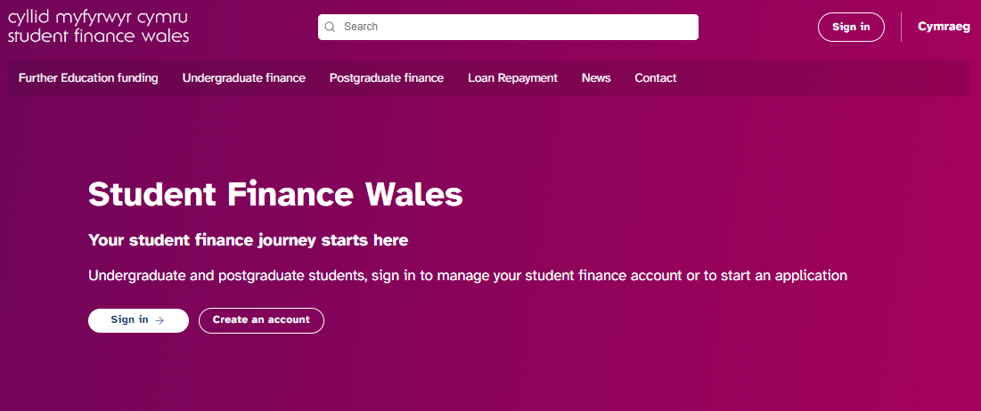
Online application troubleshooting
Recommend using a laptop or tablet
Make sure the right sections are signed and dated – students will be prompted
Use correct learning centre name
Questions should be answered from the student's perspective except the guardian details and income section
Only select Current Year Income assessment if applicable
Misunderstanding as to what third party means
Ensure correct National Insurance numbers provided
Double check before they hit submit!
Review documentary evidence requirements

Slide 16
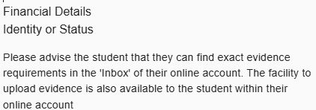
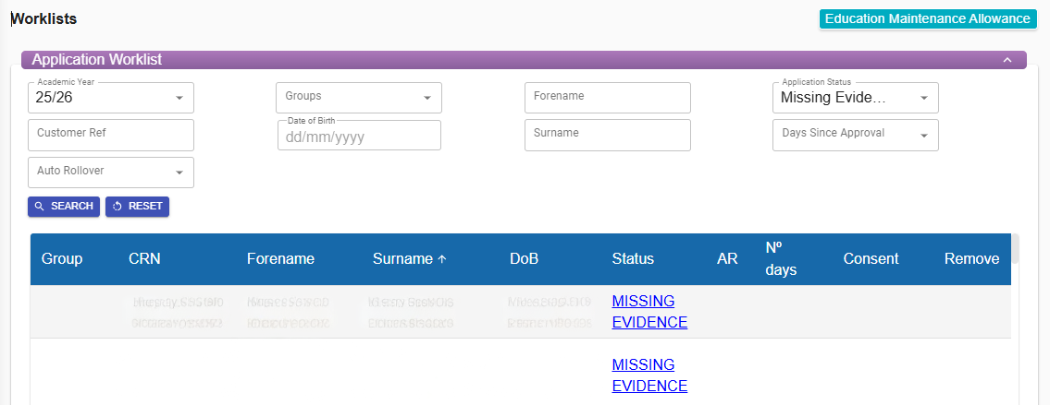
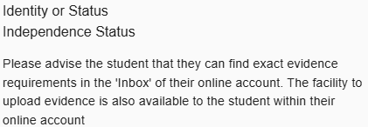
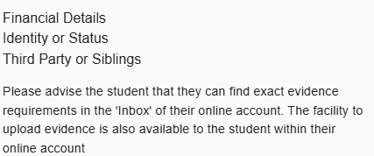
Missing evidence link

Slide 17
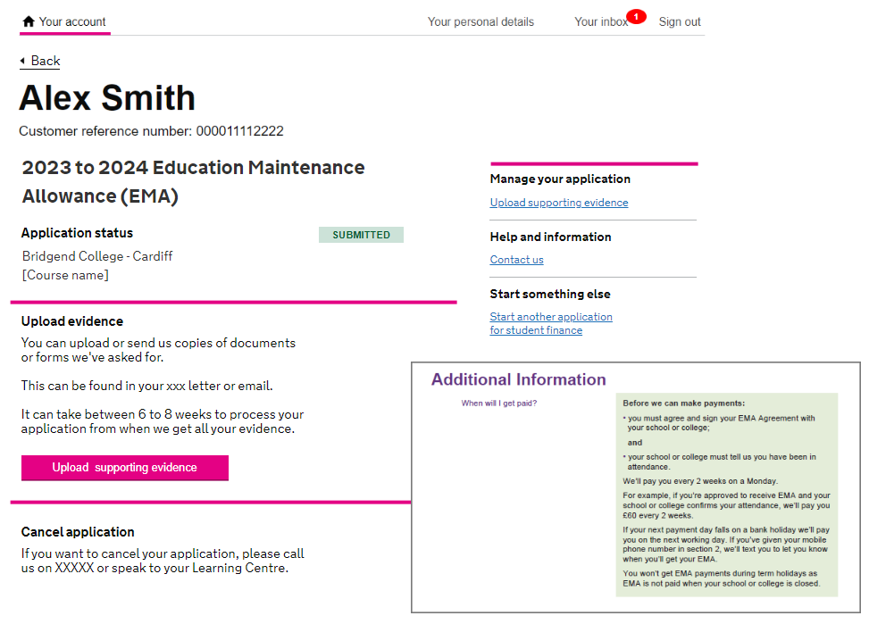
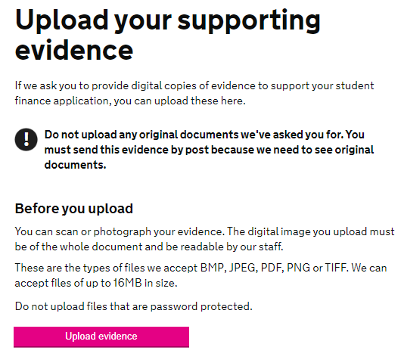
Uploading evidence

Slide 18
Common questions
What date do students need to sign their learning agreement by to be eligible for the January bonus?
Students need to sign their learning agreement by 2 December.
If you need to give a new member of staff access to the portal, what should you do?
You can create a new user in the maintenance section of the portal. You should also expire any users who no longer require access.
How much can a student be absent before it starts to affect their EMA?
As per the guidance, there is no cap on how many times a student can be off ill as long as you’re confident the illness is genuine.

Slide 19
Remove, Stop or Suspend
Remove
Remove should only be used if a student has NOT signed a leaning agreement
If a student leaves the LC permanently, you must stop the EMA Agreement. You no longer need to record attendance, and we’ll not make any more payments
Stop
Suspend
Used for students who are absent long term from
LC and you are unsure if their absence will be permanent. You can reactivate the EMA Agreement should they return

Slide 20
Under what circumstances should I use remove, stop, suspend?
You should only remove a student if they have not signed a learning agreement.
Remove
If a student leaves the learning centre permanently, you must stop the EMA Agreement. This will place a stop on the student record. You then no longer need to record attendance, and no more payments will be made.
Stop
You should suspend EMA Agreements for students who are absent long term from the learning centre and you are unsure if their absence will be permanent. You can then reactivate the EMA Agreement if they return.
Suspend

Slide 21


System enhancements
Delivered enhancements
  Missing evidence and information added to the LC Portal – Jan 26
  Removal of restriction on LC users being able to update previous AY apps – Sept 25
  Extenuating Circumstances indicator on EMA Wales and WGLG attendance worklist screen and confirm attendance screen – Aug 25
Enhancements on our wish list
Re-set average days – if an application is awaiting information, the average days are still counting (typically when they have been sample checked)
WGLG to mirror EMA (adding links and removals)

Slide 22
Learning Agreements

Slide 23
EMA review July 2024
Student Finance Wales (SFW) guidance – focus on being fair and reasonable when determining attendance status
Students must have 100% attendance. They cannot miss one registration or one lesson. If they do, they do not get the payment.
Missed payments was the biggest issue raised by EMA recipients over the course of the review and this was found to cause much anxiety and concern for learners. Learners considered it particularly unfair that they lost the total £40 payment for only having missed one lesson or registration period.
Some schools only require learners to be present for their lessons whereas others require them to be present for registration sessions as well.
Members of the FEI Student Service Network called for more consistent guidance around attendance as the current guidance was open to interpretation and resulted in an inequitable offer for learners.

Slide 24
Learning Agreement example
To receive your EMA you must attend 100% of your timetabled lessons.
Authorised absences can be considered as in attendance. A list of these can be provided by your school or college. The school or college has discretion if they believe the absence not to be genuine.
If you are ill, you can self certify for up to 5 days in a row. After this evidence such as a medical certificate will need to be provided.
Any unauthorised absences will result in nonpayment of EMA (evidence to support an unauthorised absence may be accepted within 3 weeks of the absence).
Any holidays authorised during term times will not be eligible for EMA payment.
You must be studying a course of a minimum of 12 hours to be eligible for EMA. For example, if the student is expected to attend for 20 hours, they must attend for 20 hours.
If you wish to appeal an attendance confirmation decision, please ask the learning centre for further guidance.

Slide 25
Government updates

Slide 26
The Welsh Government is increasing the household income thresholds for EMA for AY 2026/27
New household income thresholds for EMA Wales new and continuing students from academic year 2026/27:
  £24,570 if the student is the only child in the household (previously £23,400)
  £27,273 if there is at least one other dependent child eligible for Child Benefit in the household (previously £25,974)
Bereaved partners of Gurkhas and Hong Kong veterans​ (Wales)
From AY 2026/27, bereaved partners and their children, of Gurkhas and Hong Kong military veterans discharged before 1 July 1997 will be eligible for full student support, aligned with the existing “protected partner” category. They will not need to meet the three‑year ordinary residence rule but must be ordinarily resident in Wales on the first day of the academic year and in the UK and Islands since their most recent grant of leave.​
Leave under the ARR (Afghan Response Route)
From AY 2025/26 (England & NI) and AY 2026/27 (Wales), students with leave under ARR (Afghan Response Route) and their eligible family members can apply for all student finance products (FE, UG, PG) without meeting the three-year ordinary residence requirement. Eligible statuses include Indefinite Leave to Remain (ILR) and Indefinite Leave to Enter (ILE). This applies to new and continuing students from the effective dates. This aligns ARR with other Afghan protection schemes for equal access to funding.​
EMA applicants can provide NINO for income assessment
A change will be introduced for students and sponsors’ income to be verified by National Insurance number without having to provide any financial information (this will mirror the process for HE)
Response to the Independent Review of the Welsh Government Learning Grant
Published March 2026
​

Slide 27
Important dates

Slide 28


16 March
Little book of EMA and Guide to WGLG delivered to larger colleges
23 March
EMA/WGLG application forms delivered as set out
27 April
AY 2026/27 application launch
Learning agreements and nominated learning agreements for AY 2026/27
Auto rollover
Apply now posters
Payment information guide
7 September
AY 2026/27 EMA/WGLG academic year start date
This is when we begin to count the 10-day period for students to sign their learning agreements

Slide 29
AY 2025/26 service update

Slide 30
Service standards
Service measure | Standard
Learning Agreement Confirmations | New students: 100% within 10 working days of an approved application (SLC provides start date) Returning students: 100% within 10 working days from the first full week of academic year – (SLC provides start date)
Attendance Confirmations | EMA: 100% attendance confirmations weekly WGLG FE: 50% Oct/Feb/May 100% Dec/March/June
Notice of Changes (WGLG FE) | 100% within 10 working days (from when the change occurred)
Removals (Outstanding Learning Agreements) | 100% within 10 working days of approved application by first full week of academic year
Withdrawals | 100% within 30 working days

Slide 31
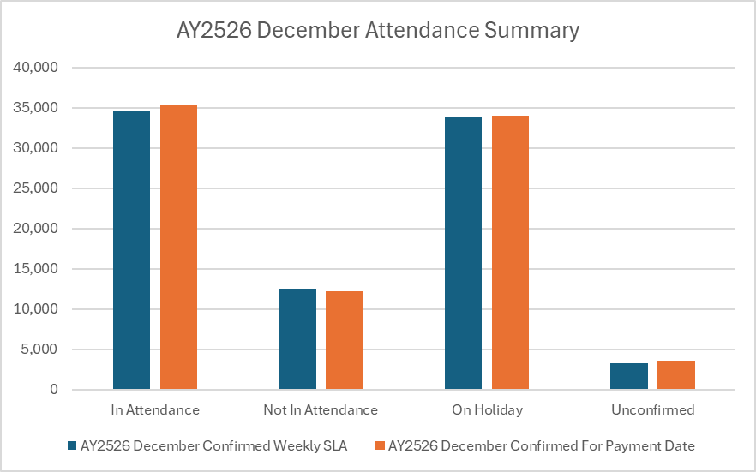
EMA Wales attendance confirmations
December 2025
Attendance as at | Week end date | Payment date | Number with Learning Agreement | In attendance | Not in attendance | On holiday | Total confirmed | Total unconfirmed | % confirmed
11/12/2025 | 05/12/2025 | 15/12/2025 | 17,066 | 11,962 | 4,724 | 7 | 16,693 | 373 | 97.8%
18/12/2025 | 12/12/2025 | 29/12/2025 | 16,164 | 11,783 | 4,281 | 5 | 16,069 | 95 | 99.4%
25/12/2025 | 12/12/2025 | 29/12/2025 | 16,974 | 12,536 | 4,013 | 5 | 16,554 | 420 | 97.5%
25/12/2025 | 19/12/2025 | 29/12/2025 | 16,974 | 10,857 | 3,474 | 35 | 14,366 | 2,608 | 84.6%
01/01/2026 | 26/12/2025 | 12/01/2026 | 16,986 | 0 | 0 | 16,878 | 16,878 | 108 | 99.4%
08/01/2026 | 26/12/2025 | 12/01/2026 | 17,057 | 0 | 0 | 16,976 | 16,976 | 81 | 99.5%
08/01/2026 | 02/01/2025 | 12/01/2026 | 17,057 | 0 | 0 | 16,978 | 16,978 | 79 | 99.5%

Slide 32
EMA Wales Learning Agreements
EMA Learning Agreements | AY23/24 | AY24/25 | AY25/26
Average working days | 6 | 6 | 6

Slide 33
WGLG Learning Agreements and withdrawals
WGLG Learning Agreements | AY23/24 | AY24/25 | AY25/26
Average working days | 5 | 5 | 5
WGLG Withdrawals (cumulative) | AY23/24 | AY24/25 | AY25/26
Number of Withdrawals | 101 | 175 | 144
No within 10 working days | 65 | 117 | 103
Percentage achieved | 64.4% | 66.9% | 71.5%

Slide 34

Summary
Promote funding by using materials provided by SLC and internal tools
Encourage learners to apply online as soon as possible
Make sure you enter holidays by the start of the academic year
Early signing of Learning Agreements/removal of returners
100% attendances must be administered on a weekly basis
Monitor your performance via the LC Portal service standards reports
Reach out to your Account Manager for support or training needs

Slide 35

FE Account Management Team
emainfo@slc.co.uk
www.gov.uk/slc

